Slide 1
Thinking Ahead
Developing a sustainable income stream

Slide 2
Funding from grant sources
BME Community Development- August 61 schemes open; Dec- 33 open
BME Youth August- 120 Schemes open, December 94 open
BME Mental Health- December 66 Schemes Open
BME Migrants Groups- August 118 schemes Open, December 85 Open

Slide 3
What we know about the rejection rates
For almost all 2 stage applications there is an 80% rejection rate at first stage.
Second stage the rejection is 50%
In other words 90 % of applications are failing!

Slide 4
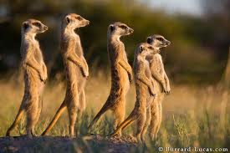
What’s your income strategy?

Slide 5
What is you strategy
Income analysis- where does your income come from. What proportion of your income comes from contracts, trading(if you are allowed to), trusts and foundations, donations
The rule of Thirds. No more than a third of your income should come from one source.

Slide 6
Return on investment
Have you thought about how you raise funds?
Raising funds from trust and foundations offers a return of 1:9
From corporate donors its a return of 1:8
From legacies its a return of 1:36
From individual donors its a return of 1:1.5 at worst and at best its a return of 1:2.5
What is your fundraising strategy?

Slide 7
You are competing for funds
In England and Wales their are 187000 registered charities
In England and Wales their are 647000 charitable organisation
The sector attracts £52 billion funding each year(£11billion from the public, about 20%)
How much did you get?
Source: Directory of social change/ NCVO/Charities Aid Foundation

Slide 8
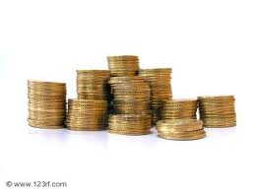
Charitable giving
Figures released December, show that over the last year (2010/11) the UK public gave £11.0 billion to charity. An additional 1.1 million people donated money to charity, however, the average (median) amount given per month fell from £12 in 2009/10 to £11.
How much did you get

Slide 9
Women aged 45-64 years are the most likely to give and give the most (typical median amount £20 per month).
Those aged 16-24 years are the least likely to give.
Who are you asking for money from?
Who is giving you money?
Are you asking for gift aid?

Slide 10
What about new technologies
Their are 12million smart phones in use in the UK
Another 2million are forecast to be sold over the next month
If 1% of all the texts sent in the UK were converted to a £1.50 donations the charity sector would raise £1.5 billion pounds Can we afford to ignore this?

Slide 11
The giving levels
Legacy donors
Corporate donors
Major donors
Regular donors
One off donors
The rest of the population- who probably dont know who you are

Slide 12
The Golden Prize
The aim of building donor relationships is encourage the whole world to support you through increasing their level of contribution up to and including a legacy.

Slide 13
What’s your income strategy?

Slide 14
For more information
If you would like more information

